Slide 1



System Level Programming
Unit 9 Garbage Collection
李靓 (Li Jing) lijing712@scu.edu.cn
School of Computer Science / Software Engineering

Slide 2
Garbage Collection 垃圾回收
9.1 Memory management mechanism 内存管理机制
9.2 Classical GC algorithms 经典GC算法
9.3 Summary 总结

Slide 3
9.1 Memory management mechanism
Dynamic memory allocation 动态内存分配
Malloc package: C standard library allocator
#include <stdlib.h>
// Successful: returns a pointer to memory block of size byte
// Failed: returns NULL
void *malloc(size_t size)
// Changes the size of p and returns pointer to a new block
void *realloc(void *p, size_t size)
// Returns the block pointed at p to pool of available memory
void free(void *p)

Slide 4
9.1 Memory management mechanism
Malloc example

Slide 5
9.1 Memory management mechanism
Why dynamic memory allocation
Programs often do not know the sizes of the data structure until the program actually runs
What is allocation 空间分配
The allocator provides an abstraction of memory as a set of blocks
{
int ct;
scanf(“%d”, &ct);
int *p = malloc(ct);
}

Slide 6
9.1 Memory management mechanism
Why we learn it?
Dynamic memory allocation is a useful and important programming technique.
Programmers need to have an understanding of how they work.
Types of dynamic memory allocation
Explicit: application allocates and frees space
C: malloc and free
Implicit: application allocates, but doesn’t free
Garbage collection in Java, Lisp or ML

Slide 7
9.1 Memory management mechanism
Allocation example

Slide 8
9.1 Memory management mechanism
Allocator constraint
Alignment request
Can not determine size of the allocation
Respond immediately
Allocate from free memory
Can not move the allocation

Slide 9
9.1 Memory management mechanism
Goal of good allocation
Good time performance
Ideally take constant time
Certainly not take linear time
Good space utilization
Allocate large fraction of the heap
Minimize “fragmentation”

Slide 10
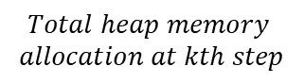
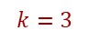
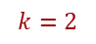
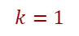

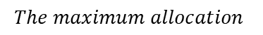
9.1 Memory management mechanism
Maximize memory utilization and fragmentation
$$k=1$$
$$k=2$$
$$k=3$$
$$U_{k}=\frac{{}_{\{i≤k\}}^{max}{P_{i}}}{H_{k}}=$$
$$The maximum allocation$$
$$Total heap memory$$
$$allocation at kth step$$

Slide 11
9.1 Memory management mechanism
External fragmentation
p4 = malloc(8)

Slide 12
9.1 Memory management mechanism
Internal fragmentation

Slide 13
9.1 Memory management mechanism
How much memory to free just given a pointer?
Keep length of a block
Requires an extra word for allocated blocks

Slide 14
9.1 Memory management mechanism
How to realize a good allocator
p = (float*)malloc(n*sizeof(float));
How do we keep track of free blocks?
Block organization
How to choose an appropriate free block and place it with a newly allocated block?
Placement
After allocation, what do we do with the remainder of the free block?
Splitting
What do we do with a block that has just been freed?
Coalescing

Slide 15
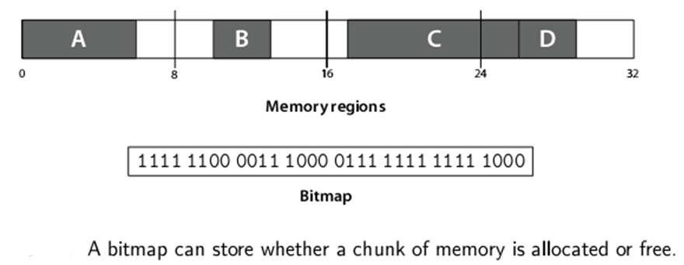
9.1 Memory management mechanism
Data representation of memory allocation?
Bitmap 位图
An array of bits, one per allocation chunk
Small chunk size | Large chunk size | Allocate K chunks

Slide 16
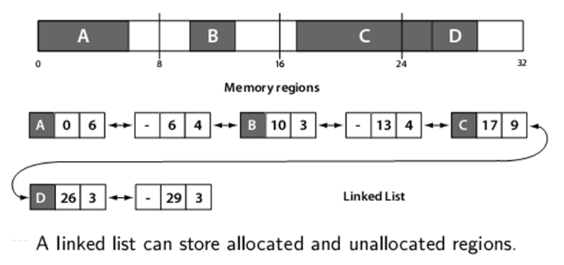
9.1 Memory management mechanism
Data representation of memory allocation?
Linked list 链表
Stores contiguous regions of free or allocated memory

Slide 17
9.1 Memory management mechanism
Keep track of free blocks
Method1: Implicit free list 隐式空闲链表
Using lengths to link all blocks
Allocated or not ?

Slide 18
9.1 Memory management mechanism
Keep track of free blocks
Method1: Implicit free list 隐式空闲链表
An extra 1 bit to identity free or allocated
At low order bit of block size

Slide 19
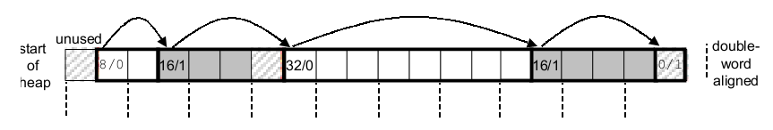
9.1 Memory management mechanism
Keep track of free blocks
Method1: Implicit free list 隐式空闲链表
Using lengths to link all blocks
Organizing the heap with an implicit free list.
32bit machine:
Word = 4 Byte
Double word = 8 Byte
Terminating header

Slide 20
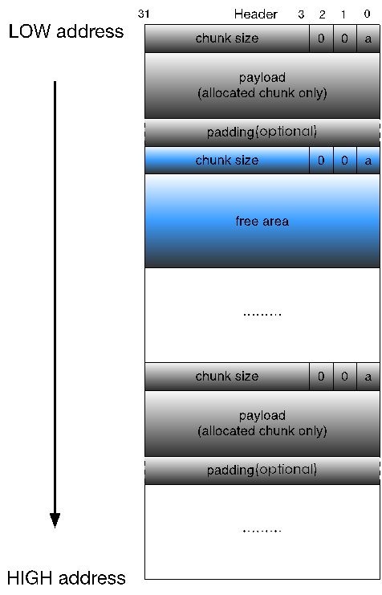
9.1 Memory management mechanism

Slide 21
9.1 Memory management mechanism
Finding free blocks - Placement policy
First Fit 首次适应法
Next Fit 循环首次适应法
Best Fit 最佳适应法
Search list from beginning, select first free block that fits
In practice it can cause “splinters” at the begging of list
P = malloc(3)
P = malloc(3)

Slide 22
9.1 Memory management mechanism
Finding free blocks - Placement policy
First Fit 首次适应法
Next Fit 循环首次适应法
Best Fit 最佳适应法
Start from end of previous search, then like first fit
Research suggests that fragmentation is worse
P = malloc(3)
P = malloc(4)

Slide 23
9.1 Memory management mechanism
Finding free blocks - Placement policy 9.9.7
First Fit 首次适应法
Next Fit 循环首次适应法
Best Fit 最佳适应法
Search the list, select free block with closest size that fits
Keep fragments small
Will typically run slower than first-fit
P = malloc(5)

Slide 24
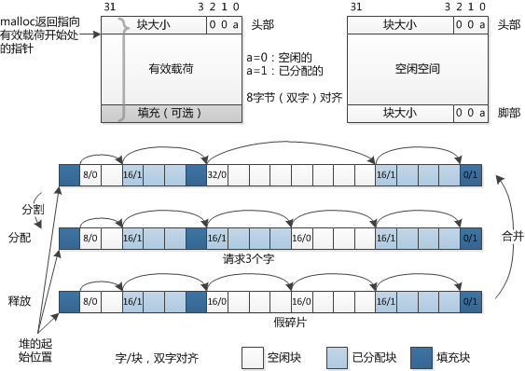
9.1 Memory management mechanism
Keep track of free blocks
Method1: Implicit free list 隐式空闲链表
Links all blocks

Slide 25
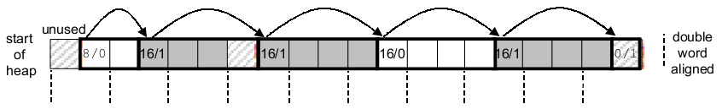
9.1 Memory management mechanism
Allocating in free block - Splitting
Splitting a free block to satisfy a three-word allocation request

Slide 26
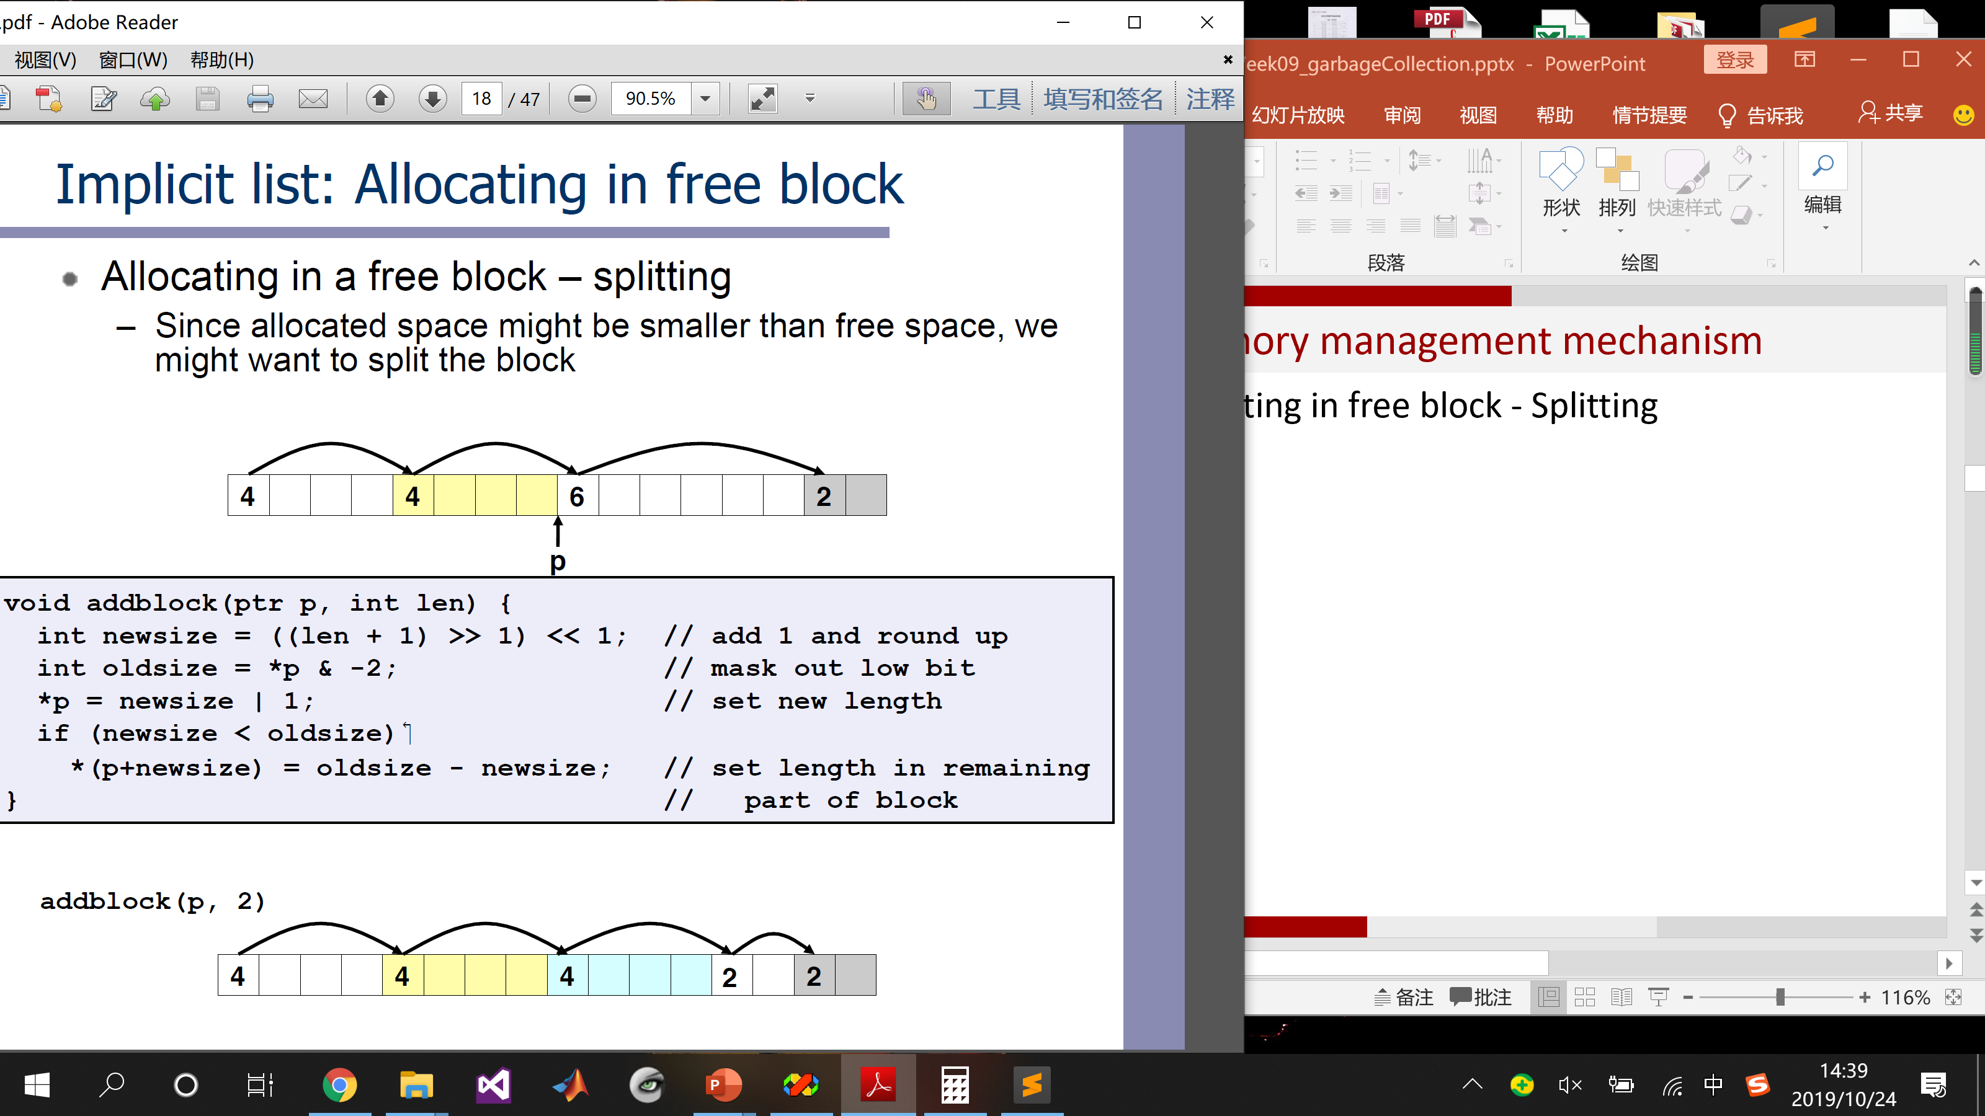
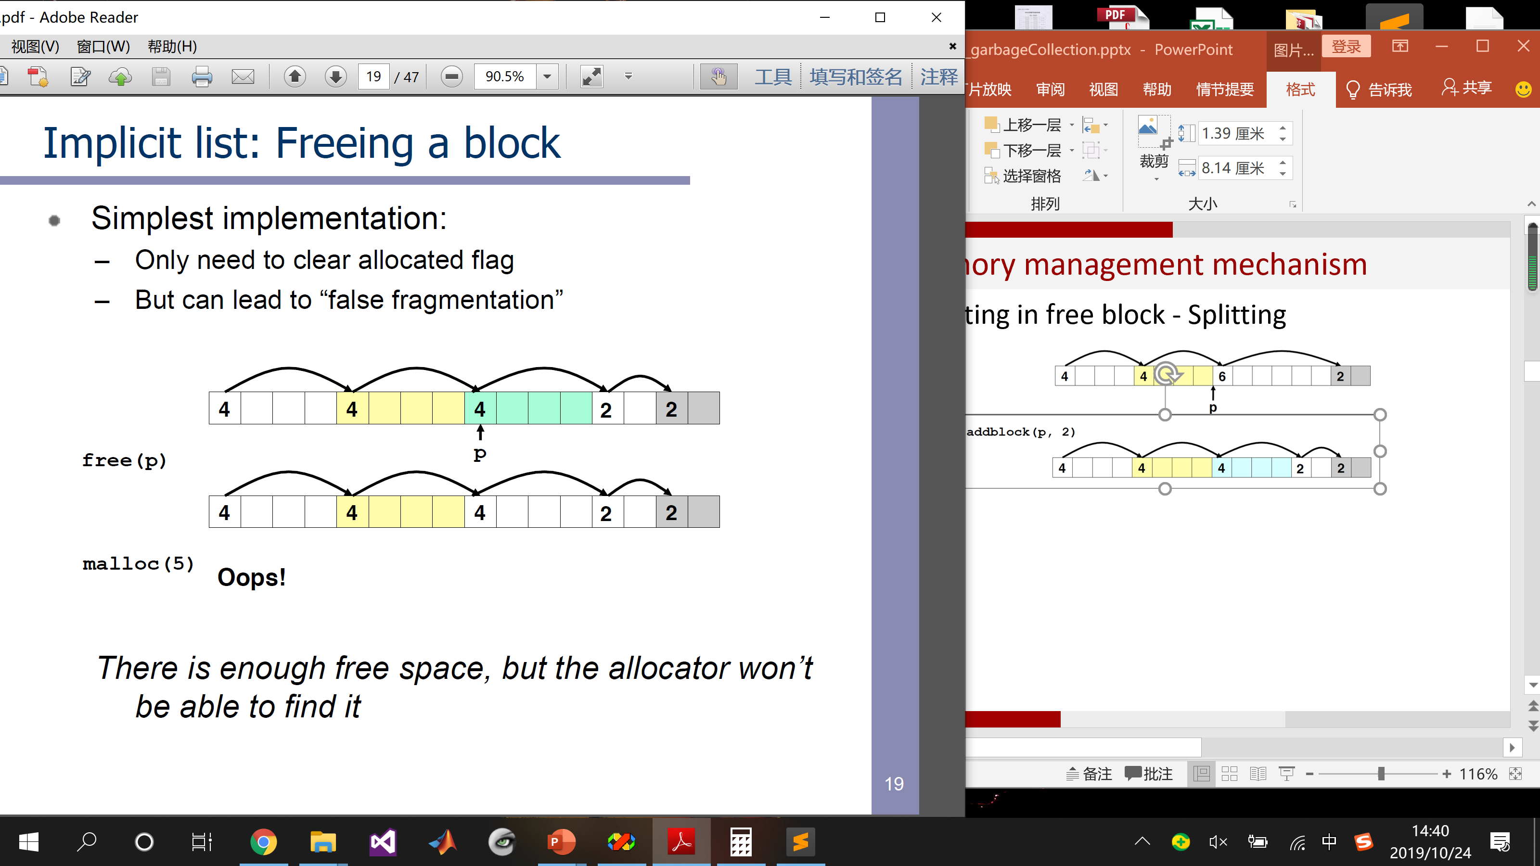
9.1 Memory management mechanism
Allocating in free block
p

Slide 27
9.1 Memory management mechanism
No existing free blocks fit
Asks the kernel for additional heap memory
Merging adjacent free blocks to yield larger free blocks
ASK FOR MORE
False fragmentation

Slide 28
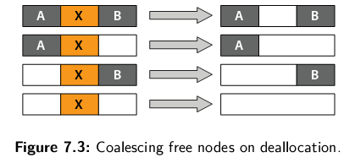
9.1 Memory management mechanism
Coalescing when deallocation
Coalescing – To combine two or more nodes into one
Immediate coalescing 立即合并
When a block is freed

Slide 29
9.1 Memory management mechanism
Coalescing when deallocation
Coalescing – To combine two or more nodes into one
Deferred coalescing 推迟合并
Fast allocators often opt for some form of deferred coalescing

Slide 30
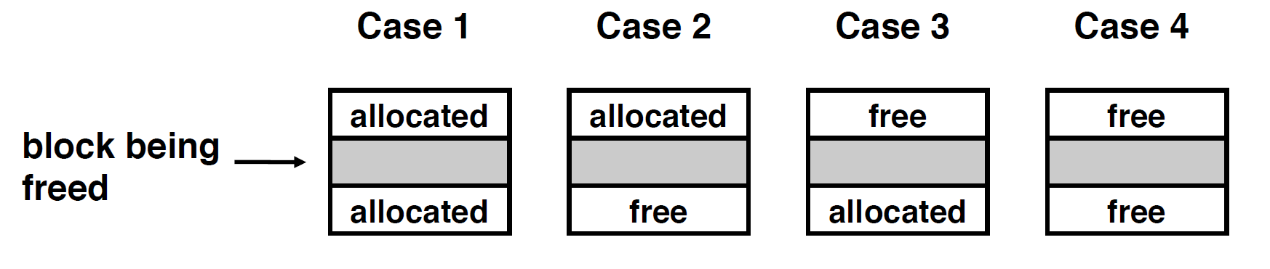
9.1 Memory management mechanism
How to do coalescing with previous free block

Slide 31
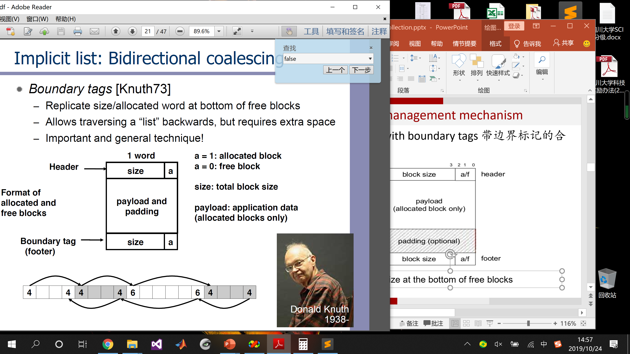
9.1 Memory management mechanism
Coalescing with boundary tags [Knuth1973]
带边界标记的合并技术
Replicate size at the bottom of free blocks

Slide 32
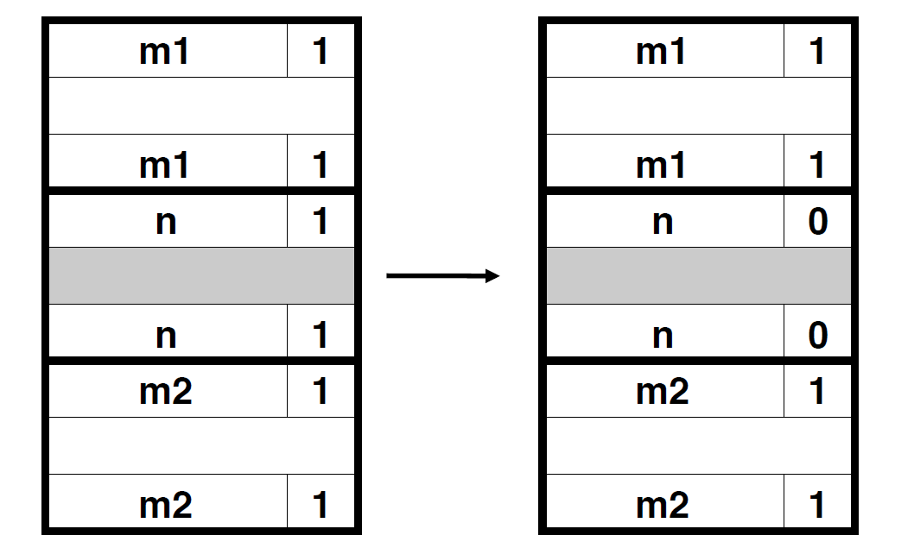
9.1 Memory management mechanism
Coalescing with boundary tags
Case 1: Both adjacent blocks are allocated

Slide 33
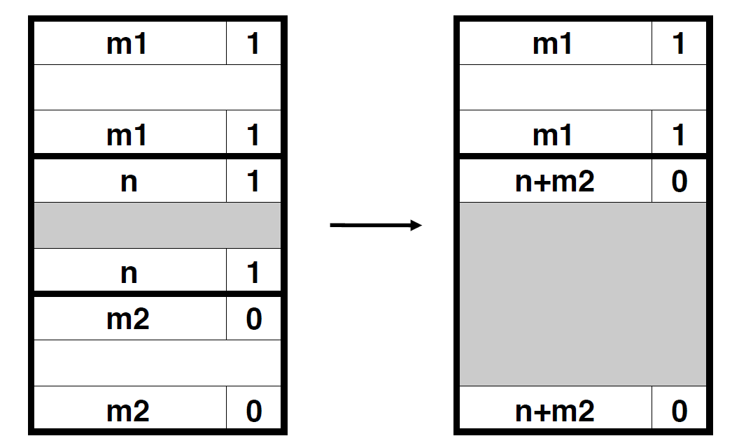
9.1 Memory management mechanism
Coalescing with boundary tags
Case 2: Update header o current and footer of the next

Slide 34
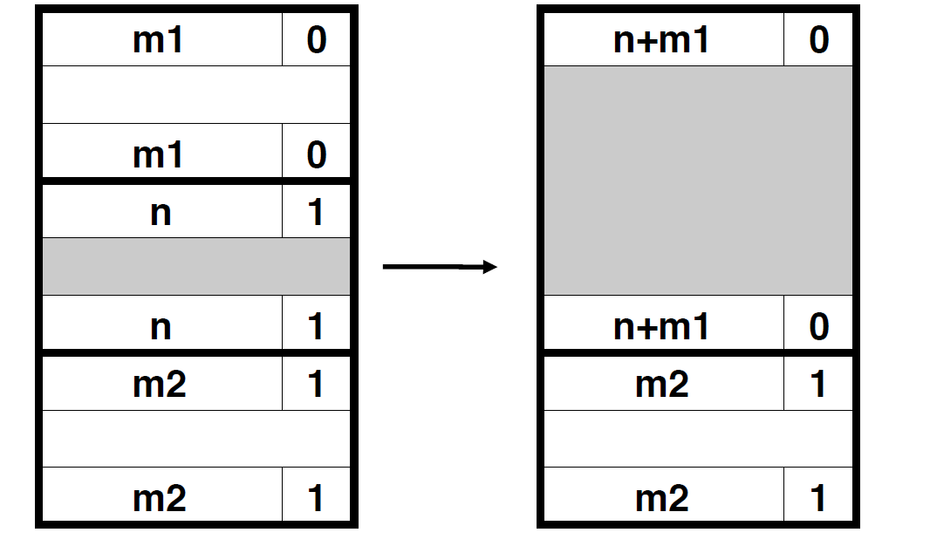
9.1 Memory management mechanism
Coalescing with boundary tags
Case 3: Update header of previous block and footer of current

Slide 35
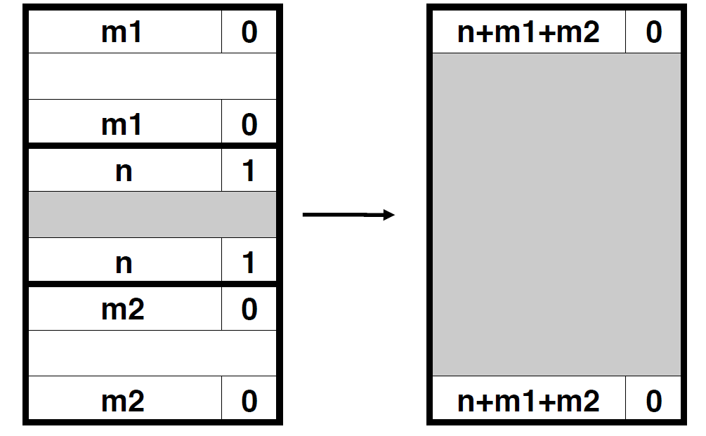
9.1 Memory management mechanism
Coalescing with boundary tags
Case 4: Update header of previous and footer of next

Slide 36
9.1 Memory management mechanism
Keep track of free blocks
Method2: Explicit free list 显式空闲链表
Using pointers within free blocks
Typically doubly linked
5
4
6
2
A
B
C

Slide 37
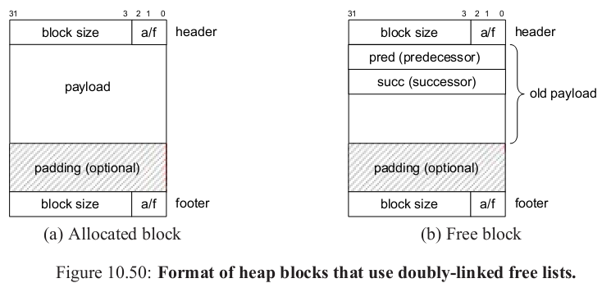
9.1 Memory management mechanism
Keep track of free blocks
Method2: Explicit free list 显式空闲链表
Using pointers within free blocks
Implicit free list Explicit free list

Slide 38
9.1 Memory management mechanism
Keep track of free blocks
Method3: Segregated free list 分离空闲链表
Different free lists for different size classes
1-2
3
4
5-8
9-16

Slide 39
9.1 Memory management mechanism
Finding free blocks - Placement policy
Segregated Fit 分离适配
Simple segregated method 简单分离存储
1-2
P = malloc(6)
3
4
5-8
9-16

Slide 40
9.1 Memory management mechanism
Finding free blocks - Placement policy
Segregated Fit 分离适配
P = malloc(10)
First-fit search
If we find one, we split it and insert the fragment in the appropriate free list
If not, we search for the next larger size class
1-2
3-4
5-8
9-16

Slide 41
9.1 Memory management mechanism
Keep track of free blocks
Method3: Segregated free list 分离空闲链表
Different free lists for different size classes
1-2
3-4
5-8
9-16

Slide 42
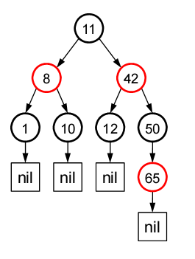
9.1 Memory management mechanism
Keep track of free blocks
Method4: Blocks sorted by size
Can use a balanced tree (e.g. Red-Black tree) with pointers within each free block, and the length used as a key

Slide 43
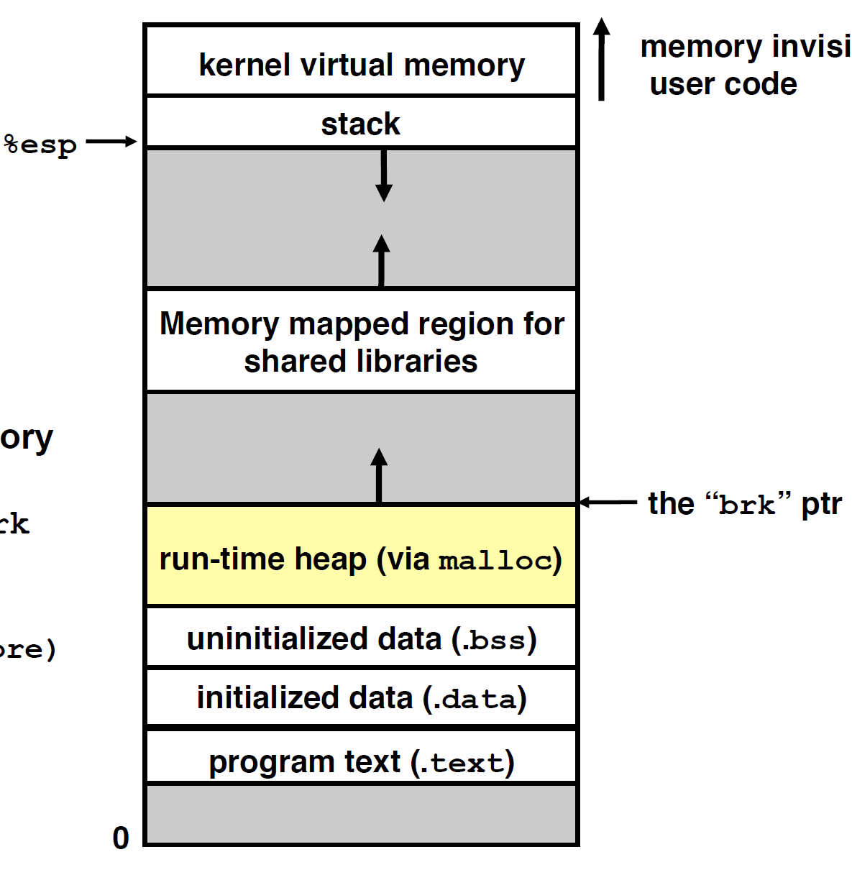
9.1 Memory management mechanism
Allocator maintains the heap for process
Maintains an area of a process’s virtual memory known as heap
Maintains the heap as a collection of various sized block
Explicitly allocate
Explicitly or implicitly deallocate

Slide 44

9.1 Memory management mechanism
Dynamic memory allocation / management
Explicit Memory Management – EMM
Automatic Memory Management – AMM (Garbage collection)
C | malloc, free
C++ | new, delete

Slide 45



9.1 Memory management mechanism
Garbage collection
Invented 1958 by John McCarthy for Lisp
Common in functional languages, scripting languages, and modern object oriented languages

Slide 46
9.1 Memory management mechanism
Garbage collection
Automatic reclamation of heap-allocated storage
Implicit memory management (Java)
Application never has to free
Lazy processing
Blocks are reorganized only if needed
void foo() {
int *p = (int*)malloc(128);
// free(p);
return; /* p is now garbage */
}

Slide 47
Garbage Collection
9.1 Memory management mechanism
9.2 Classical GC algorithms
9.3 Summary

Slide 48
9.2 Classical GC algorithms
9.2.1 Basic concepts
9.2.2 Mark and sweep collection
9.2.3 Copying collection
9.2.4 Reference counting
9.2.5 Generational garbage collection

Slide 49
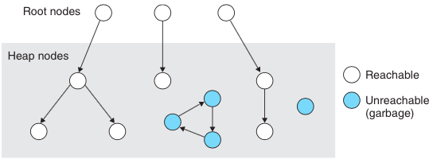
9.2.1 Basic concepts
We view memory as a directed graph, where
Each block is a node in the graph
Each pointer is an edge in the graph
Root nodes & Heap nodes
Reachable nodes & Unreachable nodes

Slide 50
9.2.2 Mark and Sweep collection
Root enumeration
Registers, locations on the stack, global variables
Global data
Local variables
Function arguments
Static storage
Register
Stack

Slide 51
9.2.2 Mark and Sweep collection
How to collect root nodes?
The runtime system needs to provide ways for the GC to collect the list of roots
.NET maintains the information on the active roots and provides APIs to the GC to enumerate them.
// Enumeration of roots
ObjectCollection roots = GetRoots();

Slide 52
9.2 Classical GC algorithms
9.2.1 Basic concepts
9.2.2 Mark and Sweep collection
9.2.3 Copying collection
9.2.4 Reference counting
9.2.5 Generational garbage collection

Slide 53
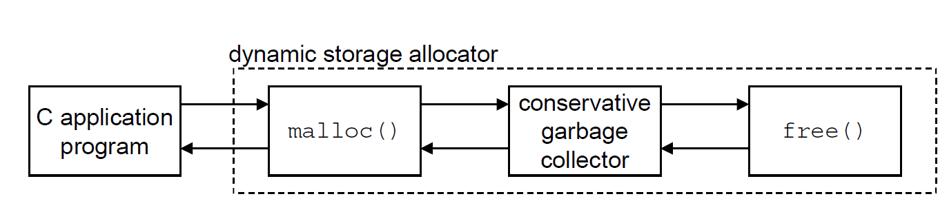
9.2.2 Mark and Sweep collection
标记清除法 (McCarthy, 1960)
Can build on top of malloc/free package
Integrating a garbage collector and a C malloc package

Slide 54
9.2.2 Mark and Sweep collection
Use extra mark bit in the head of each block
Mark – Start at roots and set mark bit on all reachable memory
Sweep – Scan all blocks and free blocks that are not marked
Root
Before mark
1 2 3 4 5 6
Marked
block header
After mark
Unmarked
block header
After sweep
Free
Free

Slide 55
9.2.2 Mark and Sweep collection
标记清除法
At the top level the algorithm in C like Pseudocode looks as follows
void GC() {
HaltAllProcessing();
// Enumeration of roots
ObjectCollection roots = GetRoots();
// Marking all object references starting from the root
for(int i = 0; i < roots.Count(); ++i)
Mark(roots[i]);
// Sweeping them
Sweep();
}

Slide 56
9.2.2 Mark and Sweep collection
A Mark&Sweep GC for programs
void mark ( ptr p )
{
if (( b = isPtr(p)) == NULL)
return;
if ( blockMarked(b))
return;
markBlock(b);
len = length(b);
for (i=0; i < len; i++)
mark(b[i]); //mark all child
return;
}
void sweep ( ptr b, ptr end )
{
while (b < end) {
if (blockMarked(b))
unmarkBlock(b);
else if (blockAllocated(b))
free(b);
b = nextBlock(b);
}
return;
}
Pseudo-code for the mark and sweep functions

Slide 57
9.2.2 Mark and Sweep collection
A Mark&Sweep GC for programs
- ptr isPtr(ptr p) If p points to some word in an allocated block, returns a pointer b to the beginning of that block. Returns NULL otherwise.
- int blockMarked(ptr b) Returns true if block b is already marked.
- int blockAllocated(ptr b) Returns true if block b is allocated.
- void markBlock(ptr b) Marks block b.
- int length(b) Returns the length in words (excluding the header) of block b.
- void unmarkBlock(ptr b) Changes the status of block b from marked to unmarked.
- ptr nextBlock(ptr b) Returns the successor of block b in the heap.

Slide 58
9.2.2 Mark and Sweep collection
A conservative Mark&Sweep GC for programs
How to determine if a word is a pointer?
ptr isPtr(ptr p)
C does not tag memory locations with any type information
There is no way for the collector to infer that the data is really an int and not a pointer
Collector confused:
a is an int or pointer ?
int a
Garbage?

Slide 59
9.2.2 Mark and Sweep collection
A conservative Mark&Sweep GC for programs
Conservative 保守的

Slide 60
9.2.2 Mark and Sweep collection
A conservative Mark&Sweep GC for programs
isPtr(ptr p) determines if p is a pointer by check if it points to an allocated memory block.
Last 2 bits are non-zero pointer
It is not in allocated heap range pointer
header
ptr

Slide 61
9.2.2 Mark and Sweep collection
A conservative Mark&Sweep GC for programs
How do we find the beginning of the block?
Use balanced tree to keep track of all allocated blocks (key – location)
Balanced tree pointers can be stored in header (two additional words)
head
data
size
left
right

Slide 62
9.2 Classical GC algorithms
9.2.1 Basic concepts
9.2.2 Mark and sweep collection
9.2.3 Copying collection
9.2.4 Reference counting
9.2.5 Generational garbage collection

Slide 63
9.2.3 Copying collection
复制法
Two heaps
Used by program
Used at GC time
From-Space
To-Space
Roots
Set

Slide 64
9.2.3 Copying collection
复制法
Advantage
Disadvantage
Faster than Mark and Sweep, because it makes only a single pass through the heap
Can only use half of your heap space
Exhibits the unpredictable periodic interruptions as Mark and Sweep

Slide 65
9.2 Classical GC algorithms
9.2.1 Basic concepts
9.2.2 Mark and sweep collection
9.2.3 Copying collection
9.2.4 Reference counting
9.2.5 Generational garbage collection

Slide 66
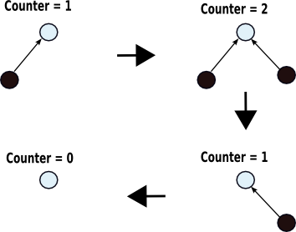
9.2.4 Reference counting
引用计数法
Keep track of the number of pointers to each object (the reference count)
When the reference count goes to 0, the object is unreachable garbage

Slide 67
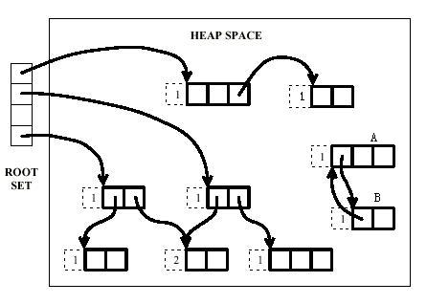
9.2.4 Reference counting
引用计数法

Slide 68
9.2.4 Reference counting
引用计数法 Disadvantage
Cost of reference counting
Ref ct. increments and decrements – time
Overhead of keep the counts – space
Fail to reclaim circular structures
root
2
1
1
1

Slide 69
9.2.4 Reference counting
引用计数法 Advantage
Dynamic and incremental fashion, and it is performed whenever there is an assignment or other heap action
This is important to maintain responsiveness in a real-time application or system

Slide 70
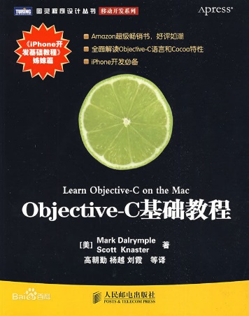
9.2.4 Reference counting
Reference counting 著名应用案例
Objective-C是扩展C的面向对象编程语言，也是iPhone开发用到的主要语言

Slide 71
9.2 Classical GC algorithms
9.2.1 Basic concepts
9.2.2 Mark and sweep collection
9.2.3 Copying collection
9.2.4 Reference counting
9.2.5 Generational garbage collection

Slide 72
9.2.5 Generational garbage collection
分代式垃圾回收法
Empirical observation
If an object has been reachable for a long time, it is likely to remain so
In many languages, most objects died young
Conclusion
Scanning the young objects frequently and the old objects infrequently
达尔文进化论：新生物种最容易被淘汰

Slide 73
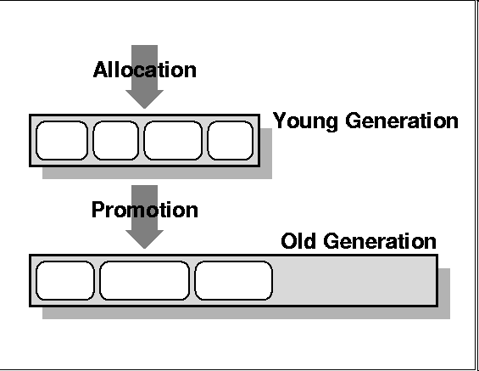
9.2.5 Generational garbage collection
分代式垃圾回收法
Assign objects to different generations G0, G1...
G0 contains young objects, most likely to be garbage
G0 scanned more often than G1
Commonly two generations (new, tenured)
G0
G1

Slide 74
9.2.5 Generational garbage collection
分代式垃圾回收法
No need to traverse the entire reference tree
The youngest generation contains the highest proportion of garbage.
By focusing the work here, the overall system is more efficient.
Older generations are garbage collected infrequently
The youngest generation can be collected in 5 to 50ms (1ms = 00.001 seconds)

Slide 75
Garbage Collection
9.1 Memory management mechanism
9.2 Classical GC algorithms
9.3 Summary

Slide 76
9.3 Summary
引用计数
引用计数是解决显式内存分配问题的常用解决方案。
实现赋值时递增和递减操作的代码通常是程序缓慢的原因之一。
无论如何，引用计数也不是全面的解决方案，因为循环引用从不会被删除。

Slide 77
9.3 Summary
什么时候执行垃圾回收？
垃圾回收只会在内存变得紧张时才会运行。
当内存尚且宽裕时，程序将全速运行，不会在释放内存上花费任何时间。

Slide 78
9.3 Summary
现代垃圾回收效率
相对于过去的缓慢的垃圾回收程序，现代的垃圾回收程序要先进得多。
分代、复制回收程序在很大程度上克服了早期的标记&清除算法的低效。
现代垃圾回收程序进行堆紧缩。
堆紧缩将减少程序引用的页的数量，这意味着内存访问命中率更高，交换将更少。

Slide 79
9.3 Summary
垃圾回收的优势
采用GC的程序不会因为内存泄漏的累积而崩溃。
采用 GC 的程序拥有更长期的稳定性。
采用GC的程序有更少的难以发现的指针错漏。
采用GC的程序开发和调试更快，因为不用开发、调试、测试或维护显式的释放代码。

Slide 80
9.3 Summary
垃圾回收的不足
内存回收何时运行是不可预测的，所以程序可能意外暂停。
运行内存回收的时间是没有上界的。尽管在实践中它的运行通常很快，但无法保证这一点。
除了回收程序以外的所有线程在回收进行时都会停止运行。
垃圾回收程序也许会留下一些本该回收的内存。

Slide 81
9.3 Summary
垃圾回收
垃圾回收应该被实现为一个基本的操作系统内核服务。
但一般情况下，GC作为程序的一部分而存在。

Slide 82
9.3 Summary
Reference
Garbage Collection in the Java HotSpot Virtual Machine, by Tony Printezis (See file: hotspot-gc.pdf)
Wikipedia on Garbage Collection (http://en.wikipedia.org/wiki/Garbage_collection_%28computer_science%29 )

Slide 83
Reference
http://blog.csdn.net/zdy0_2004/article/details/51485198 标记位
http://blog.csdn.net/yangxuefeng09/article/details/10066403 显式隐式
http://blog.csdn.net/guoping16/article/details/6579434 进程
http://blog.csdn.net/u012960981/article/details/23672969 分离链表
http://blog.csdn.net/c602273091/article/details/53576494#segregated-list 所有
http://www.cnblogs.com/andy-zcx/p/5522836.html 垃圾回收

